Slide 1
Genetic Multi-Agent Reinforcement Learning for Multiple Double-Sided STAR-RISs in Full-Duplex MIMO Networks

Slide 2
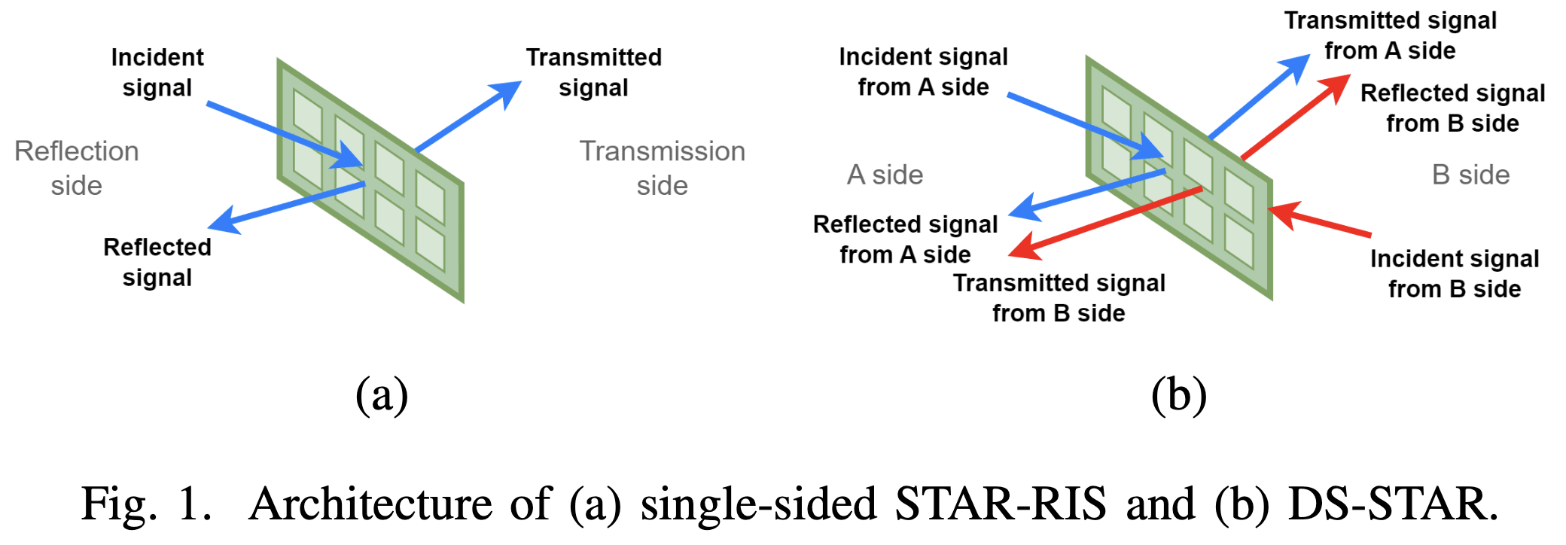
Single-sided STAR-RIS vs Double-sided STAR-RIS
Only arrive from one side
Some signals cannot be delivered
since UL/DL users may be in both sides

Slide 3
System Model

Slide 4
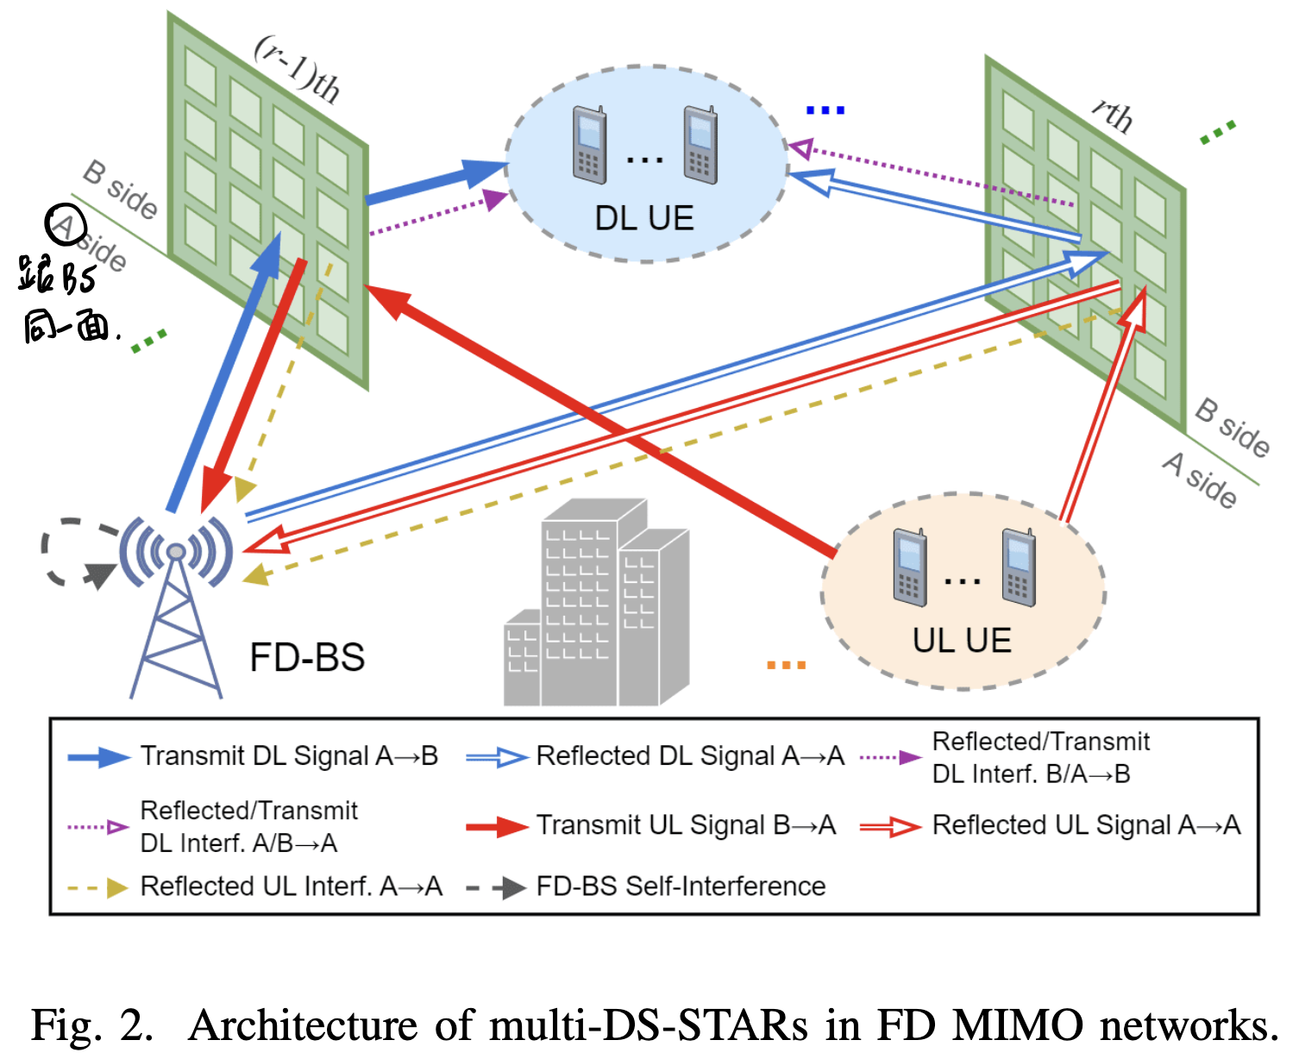
DS-STAR Model

Slide 5
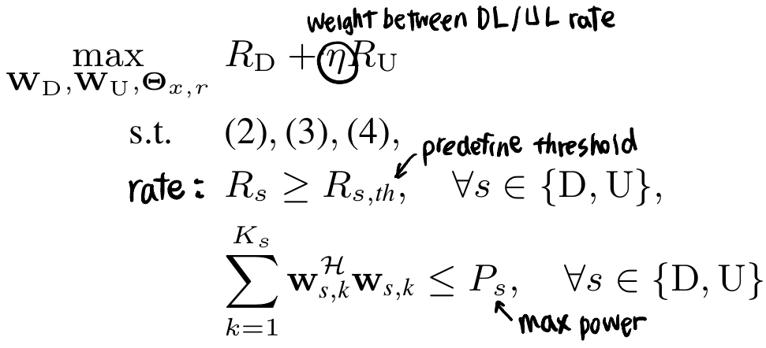
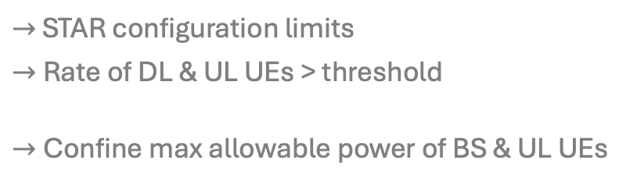
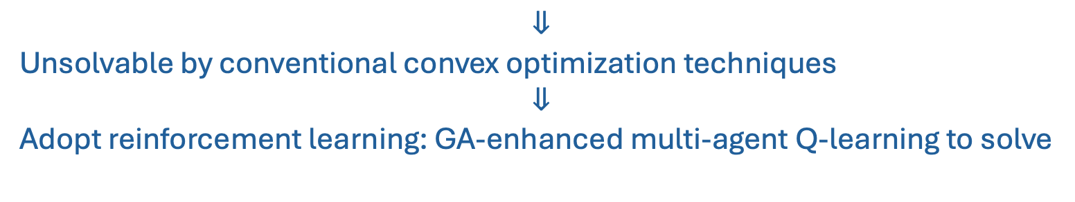
Problem Formulation
Aim to maximize the joint UL/DL rate while guaranteeing both UL/DL QoS requirements, by optimizing transmit beamforming and DS-STARs configuration:
$→$ STAR configuration limits
$→$Rate of DL & UL UEs > threshold
$→$Confine max allowable power of BS & UL UEs
$$⇓$$
Unsolvable by conventional convex optimization techniques
$$⇓$$
Adopt reinforcement learning: GA-enhanced multi-agent Q-learning to solve

Slide 6
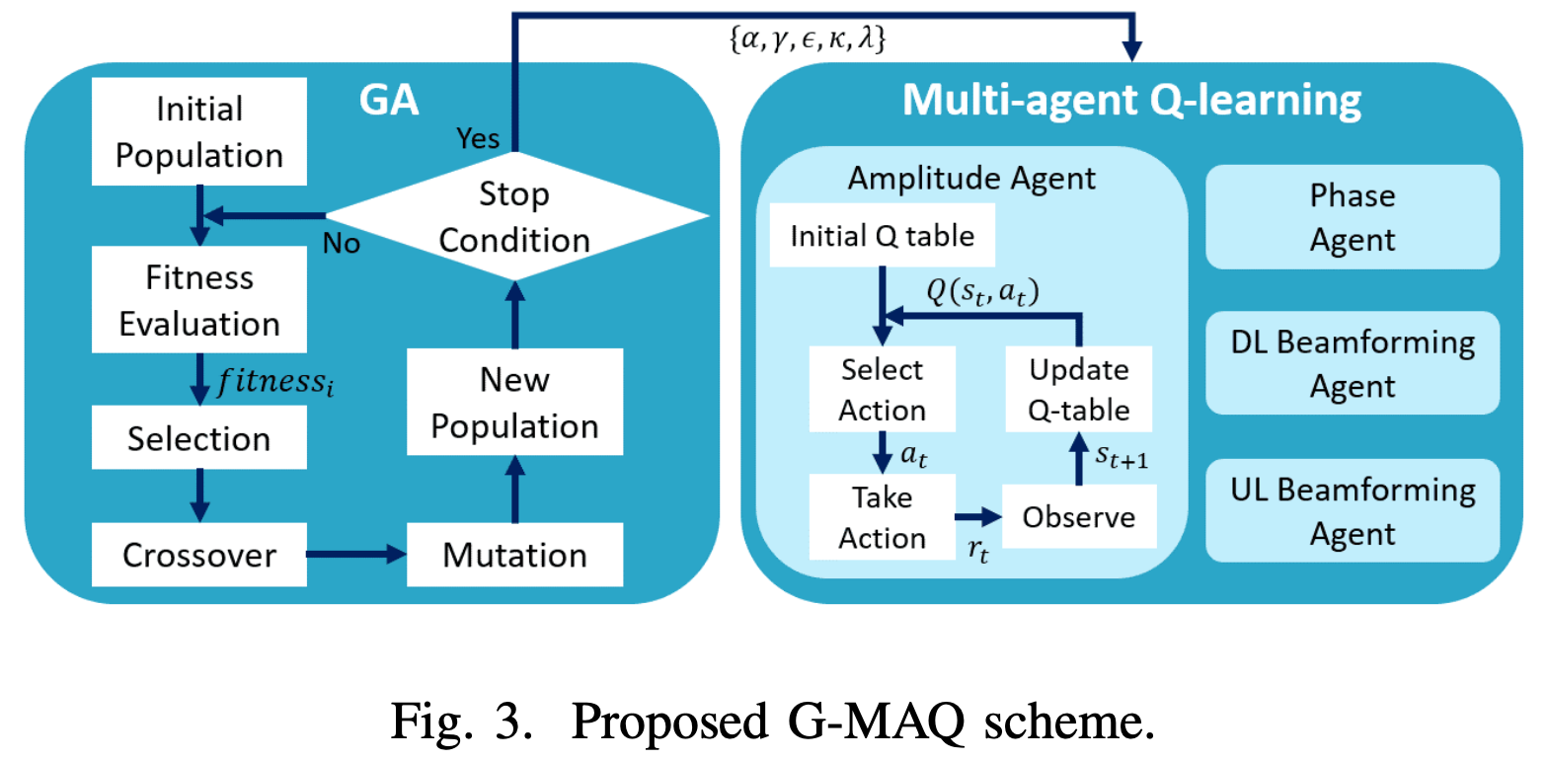
Proposed GA-enhanced Multi-agent Q-learning Scheme

Slide 7


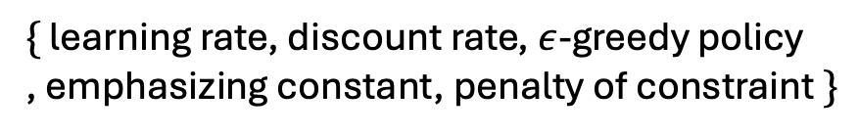
Genetic Algorithm for Hyperparameters Optimization (1/2)
Employ GA to select proper hyperparameters for Q learning.
$$:$$
$\{$ learning rate, discount rate, $ε$-greedy policy
, emphasizing constant, penalty of constraint $\}$
Q function
Reward function

Slide 8
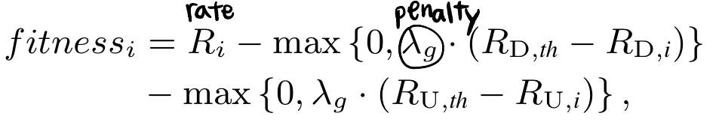
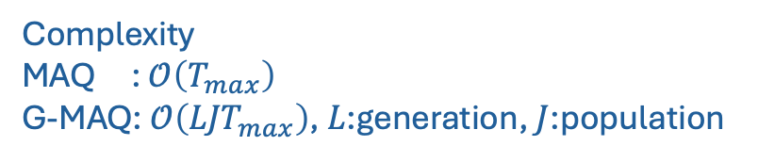
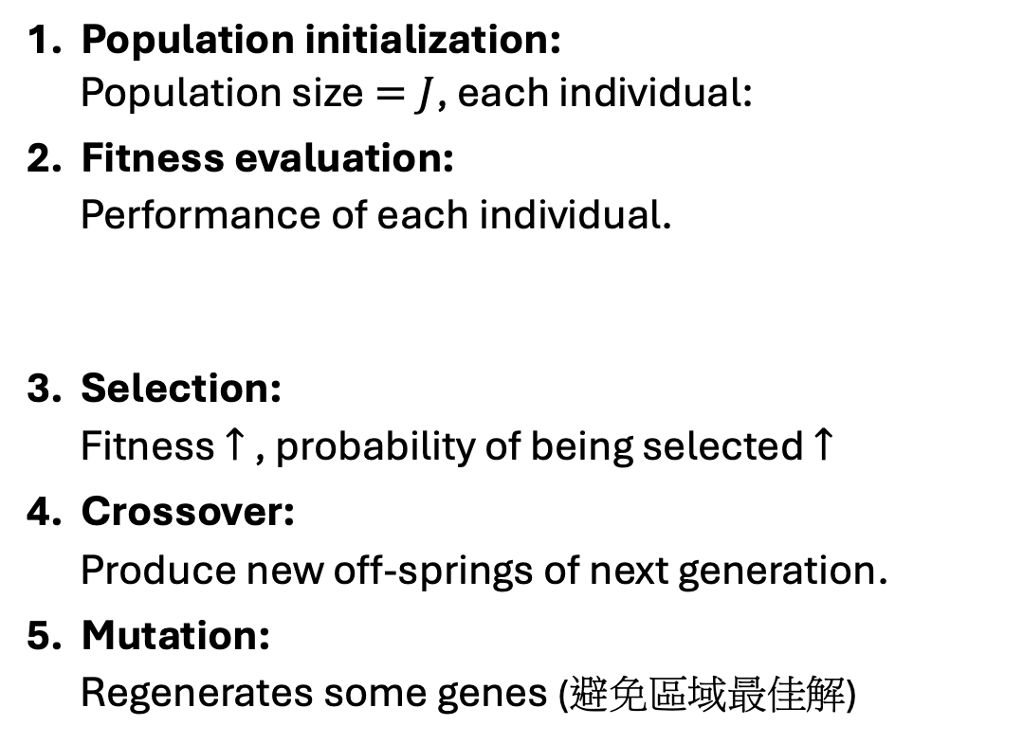
Genetic Algorithm for Hyperparameters Optimization (2/2)
1. Population initialization:
Population size$=J$, each individual:
2. Fitness evaluation:
Performance of each individual.
3. Selection:
Fitness $↑$ , probability of being selected $↑$
4. Crossover:
Produce new off-springs of next generation.
5. Mutation:
Regenerates some genes (避免區域最佳解)
Mainly determines GA’s complexity
Complexity
MAQ : $𝒪\left(T_{max}\right)$
G-MAQ: $𝒪\left({LJT}_{max}\right)$, $L$:generation, $J$:population

Slide 9
Q learning implementation:
Maze game

Slide 10
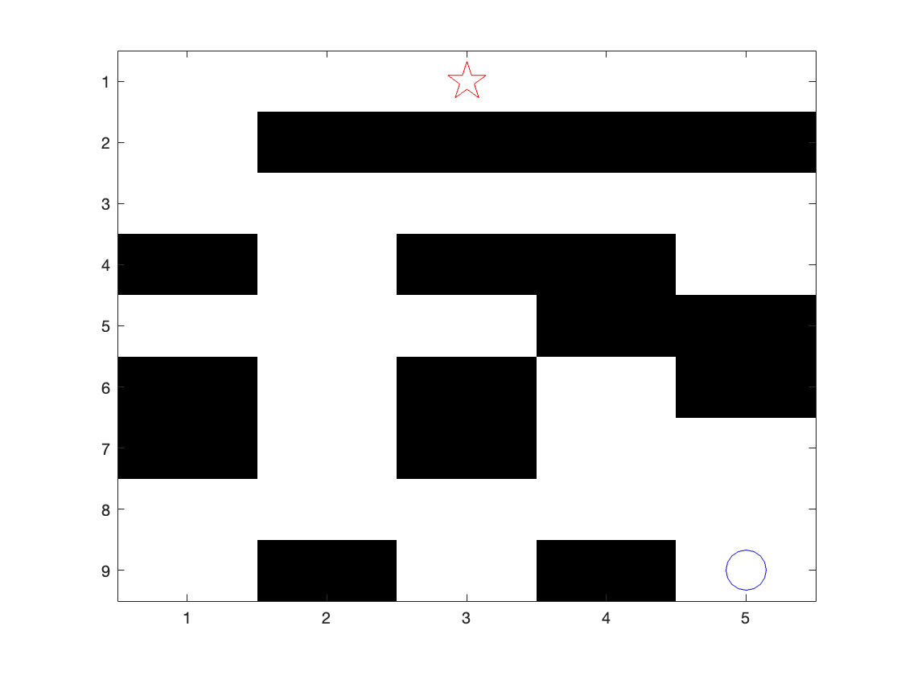
Introduction
Starting point
目的：Agent 從起點走迷宮到終點
Destination

Slide 11
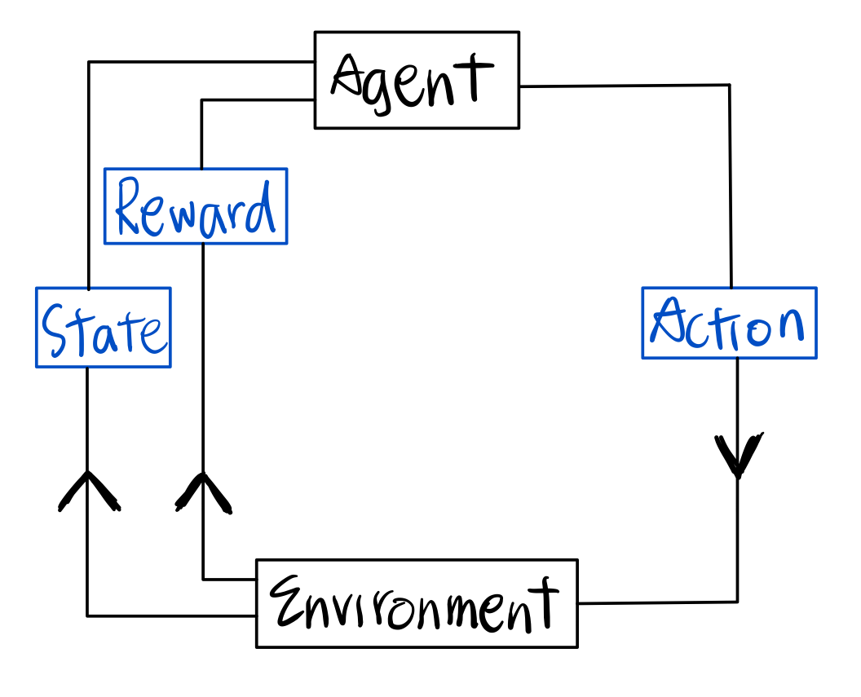
Flow Chart
Hit wall or index error: 停在原點
到終點: result=true, break
Else: do action
停在原點: -10
到終點: +100
Else: -1
上下左右
ϵ-greedy:
p=0.2: exploration
p=0.8: exploitation
maze

Slide 12
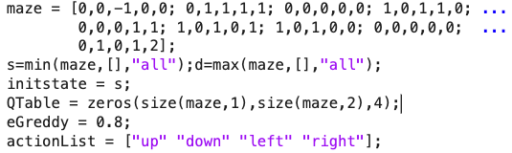
Coding detail 1/5: Initialization
Maze | 二維矩陣
Q table | 三維矩陣, 全零
Initial state | :index of -1
ϵ-greedy probability | 0.2
Actions | 上下左右

Slide 13
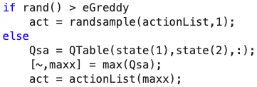
Coding detail 2/5: Get Next State from Agent
ϵ-greedy policy:
Exploration:
0.2的機率會隨機執行下一步action
Exploitation:
根據現有Q table找最大值來當成下一步action

Slide 14
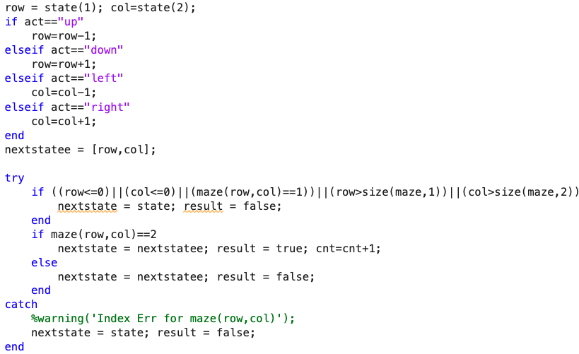
Coding detail 3/5: Do action, Update state
1. 根據action執行state (nextstatee)
Hit wall or index error: next state = 原本state
到終點: result =true, 後面會break while loop
都不是: 執行此state
2. 判斷此state是哪種情況與其對應的下一個state

Slide 15
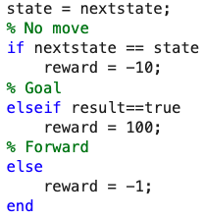
Coding detail 4/5: Reward, Update next state
Update next state
Update reward

Slide 16
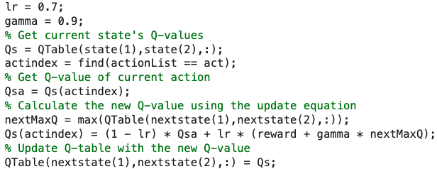
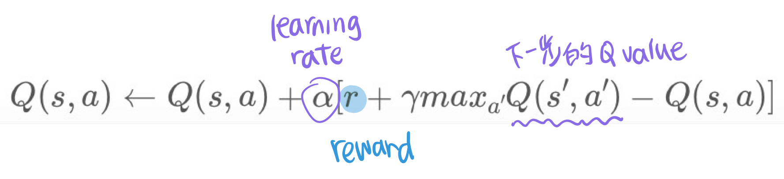
Coding detail 5/5: Update Q Table
Update Q Table based on Environmnet's response:
找current state 的q value & action index
找next state中q value最大的action
計算新的q value (q formula)
Update q table

Slide 17

Result
Agent從起點走到終點，重複執行30次的結果（已經排序後）

Slide 18
Thank You

